Slide 1
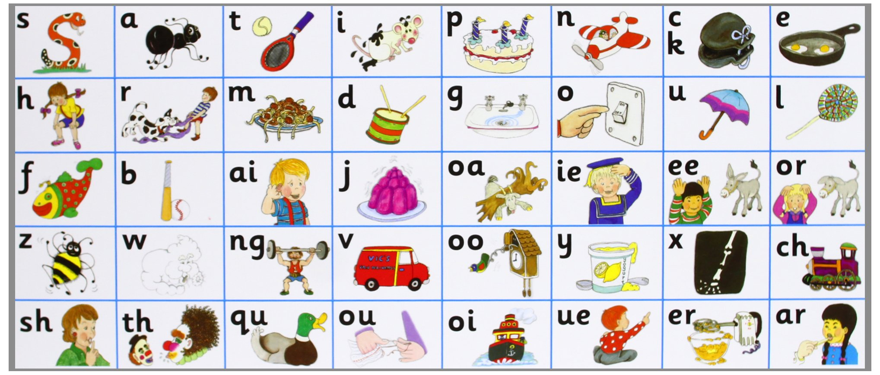
JOLLY PHONICS
(With Matua Arthur)

Slide 2
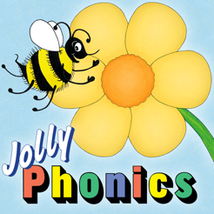
Group One: s, a,t, i, p, n

Slide 3
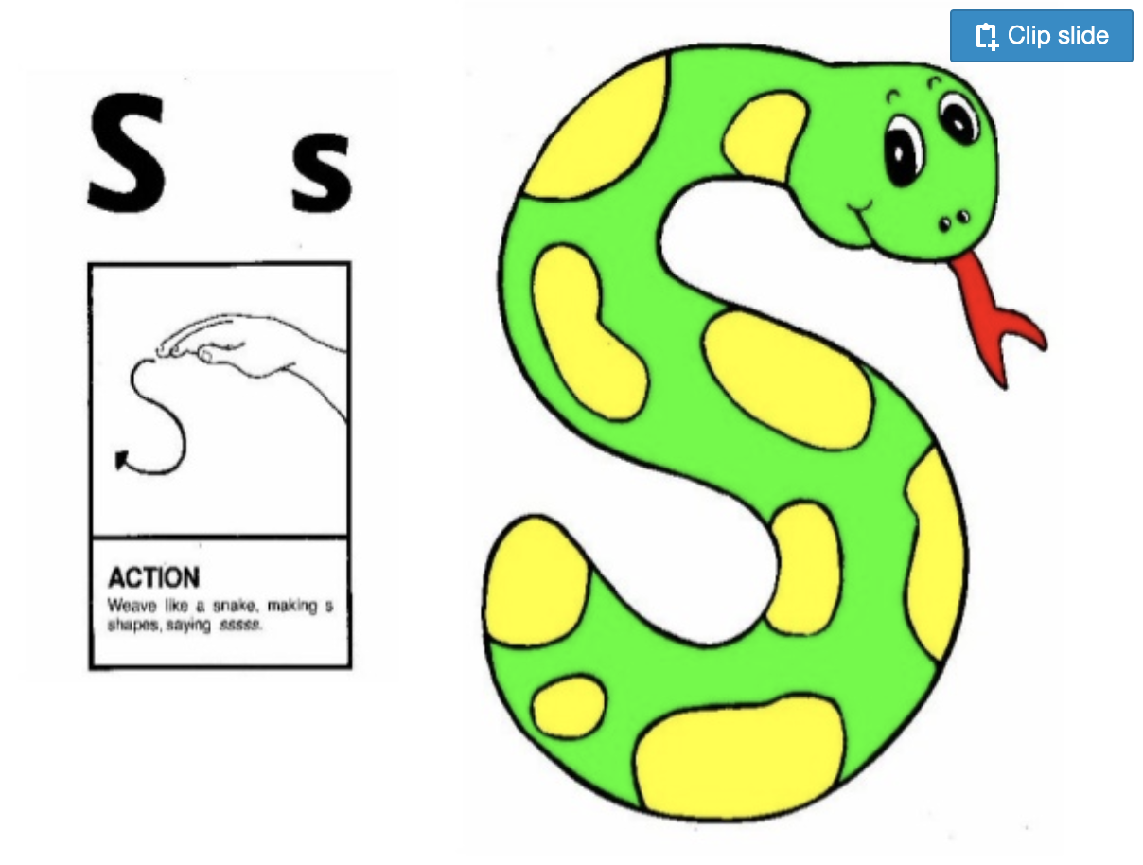
Jolly Phonic Songs in order (Click for here link)

Slide 4
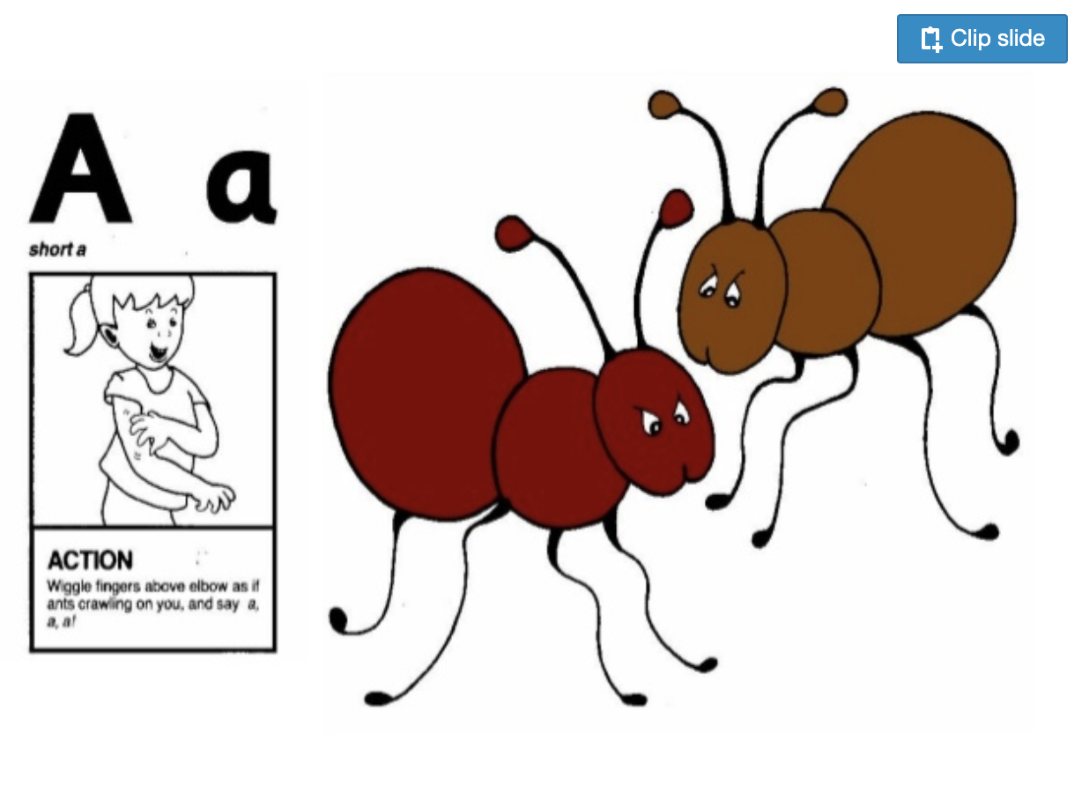
Jolly Phonic Songs in order (Click for here link)

Slide 5
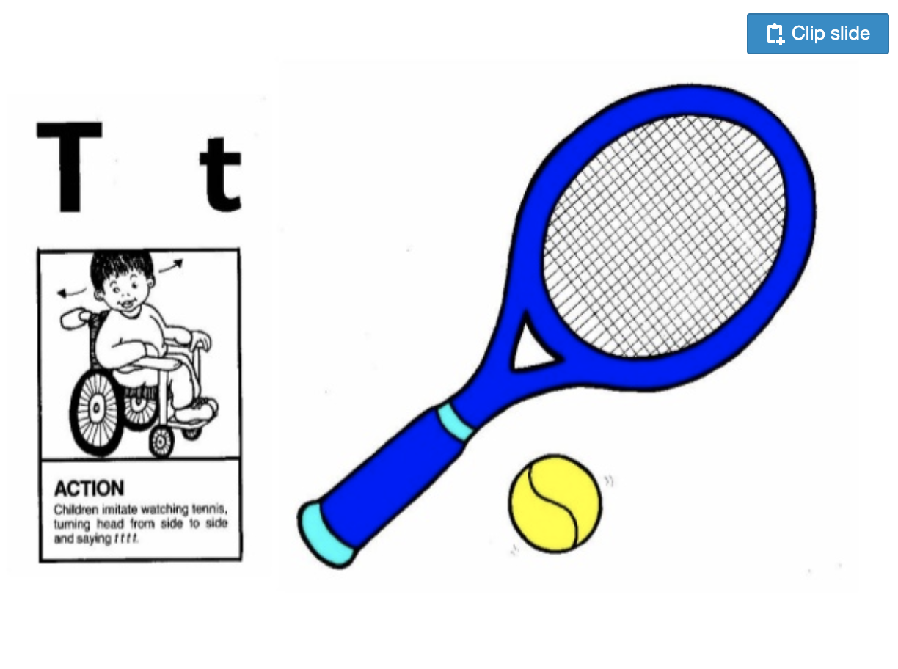
Jolly Phonic Songs in order (Click for here link)

Slide 6
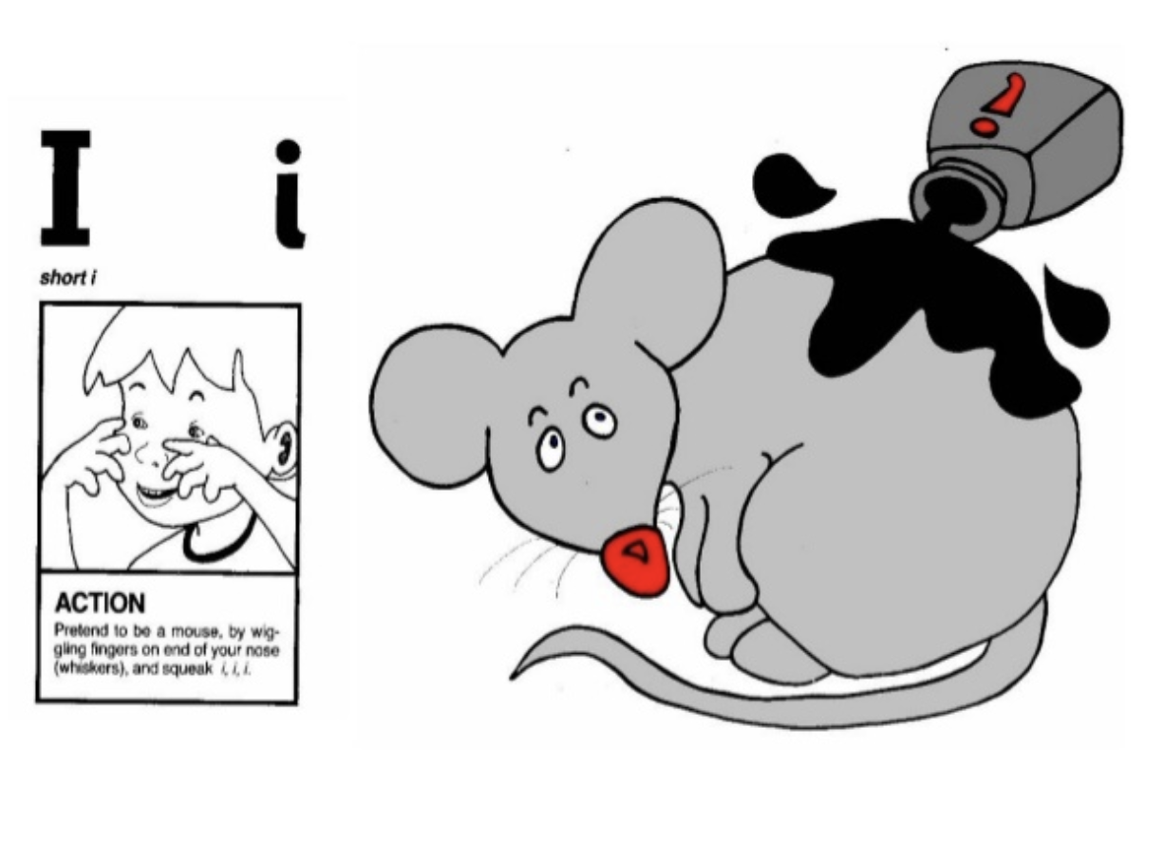
Jolly Phonic Songs in order (Click for here link)

Slide 7
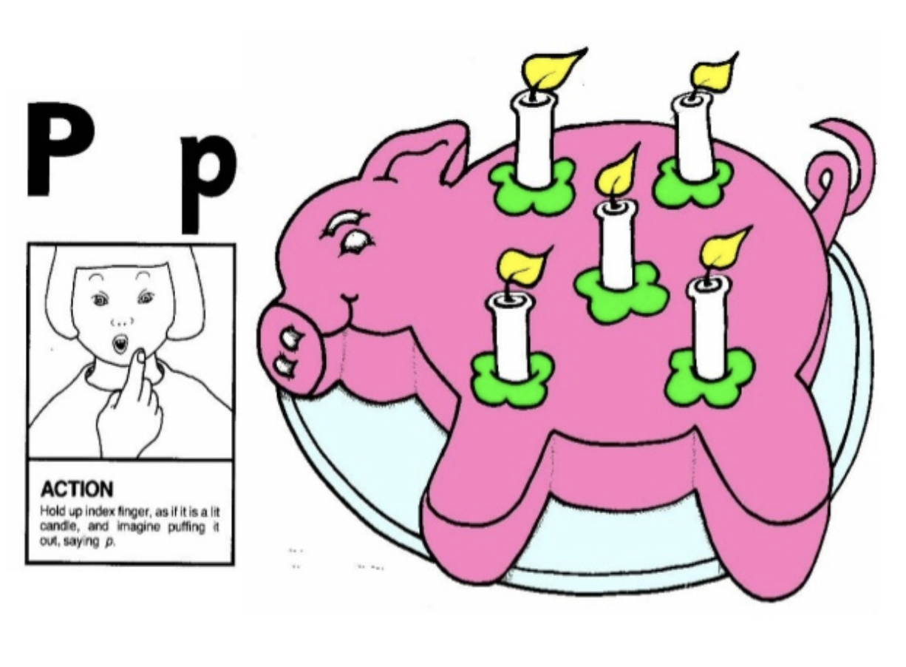
Jolly Phonic Songs in order (Click for here link)

Slide 8
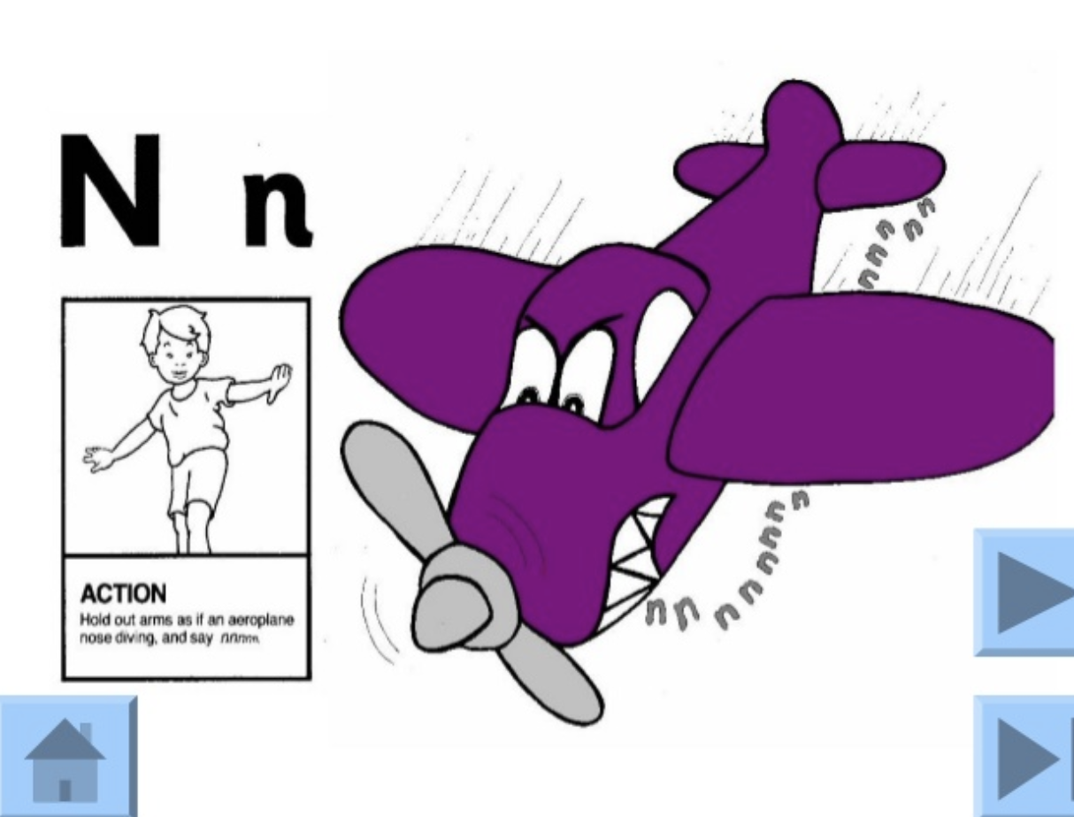
Jolly Phonic Songs in order (Click for here link)

Slide 9
Group Two: c/k, e,h, r, m, d

Slide 10
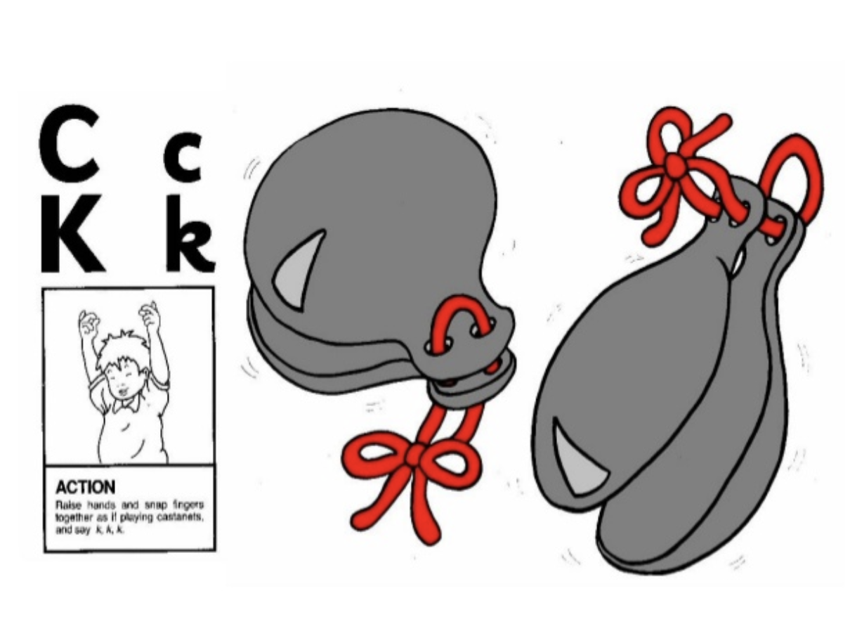
Jolly Phonic Songs in order (Click for here link)

Slide 11
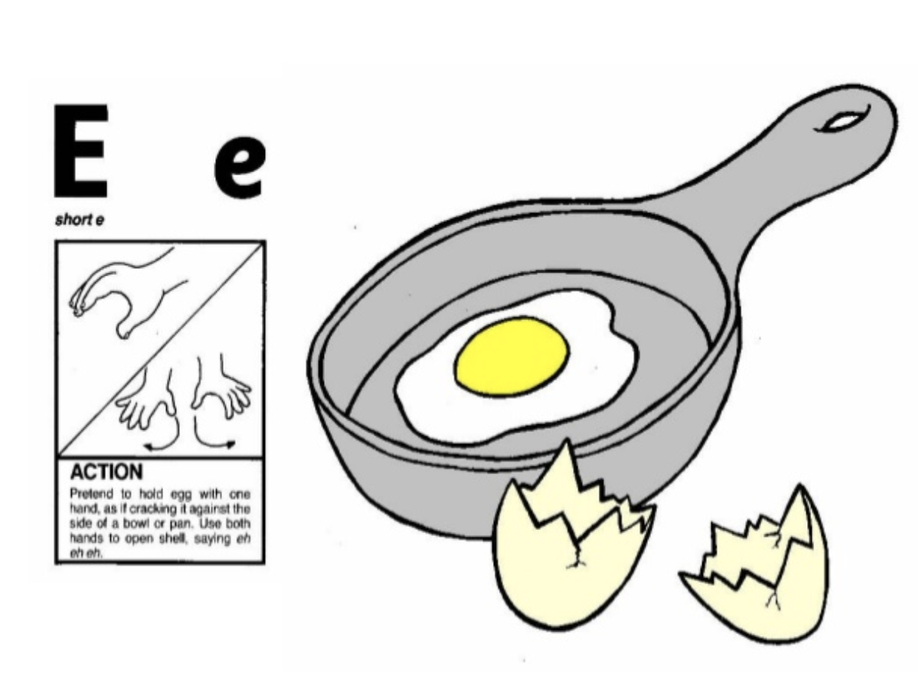
Jolly Phonic Songs in order (Click for here link)

Slide 12
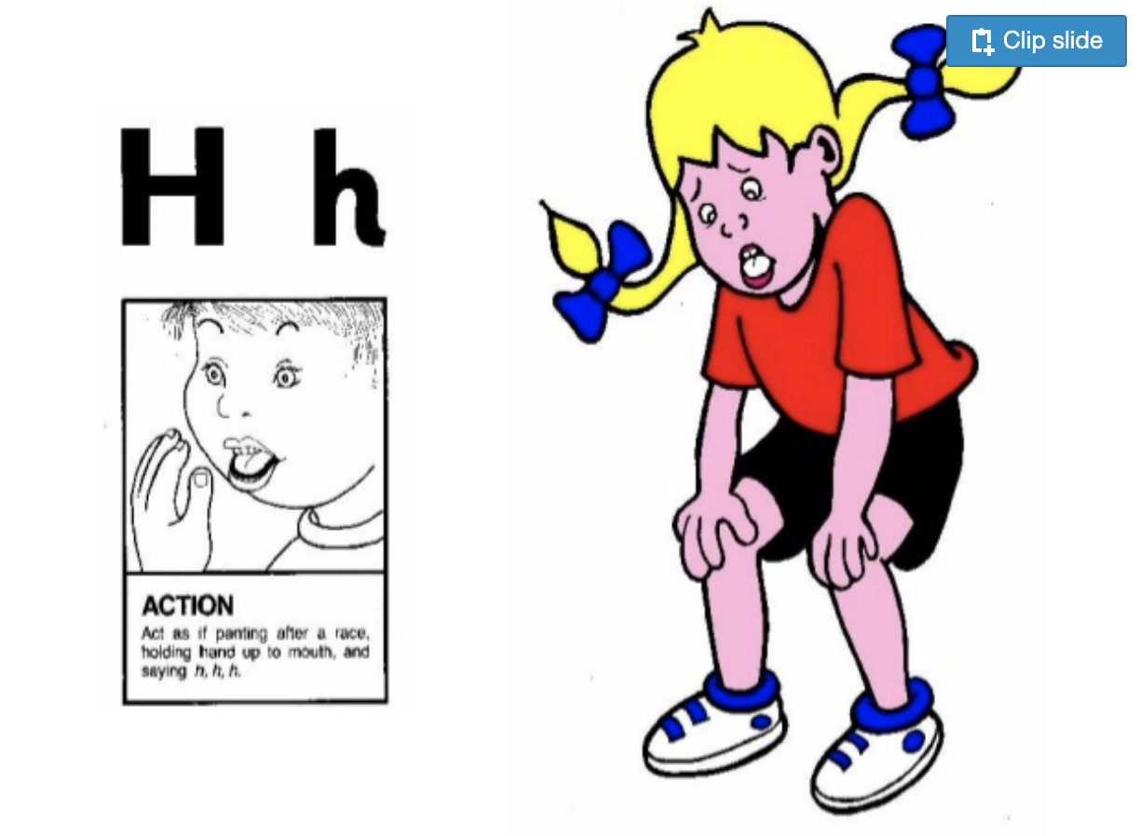
Jolly Phonic Songs in order (Click for here link)

Slide 13
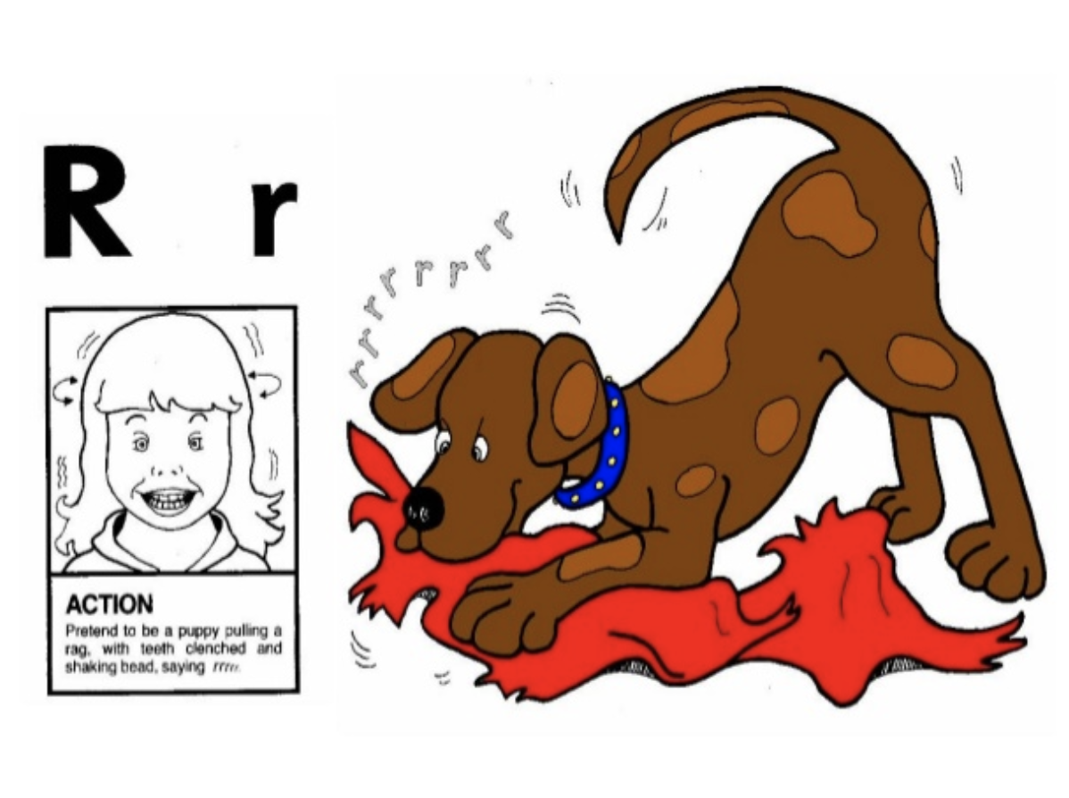
Jolly Phonic Songs in order (Click for here link)

Slide 14
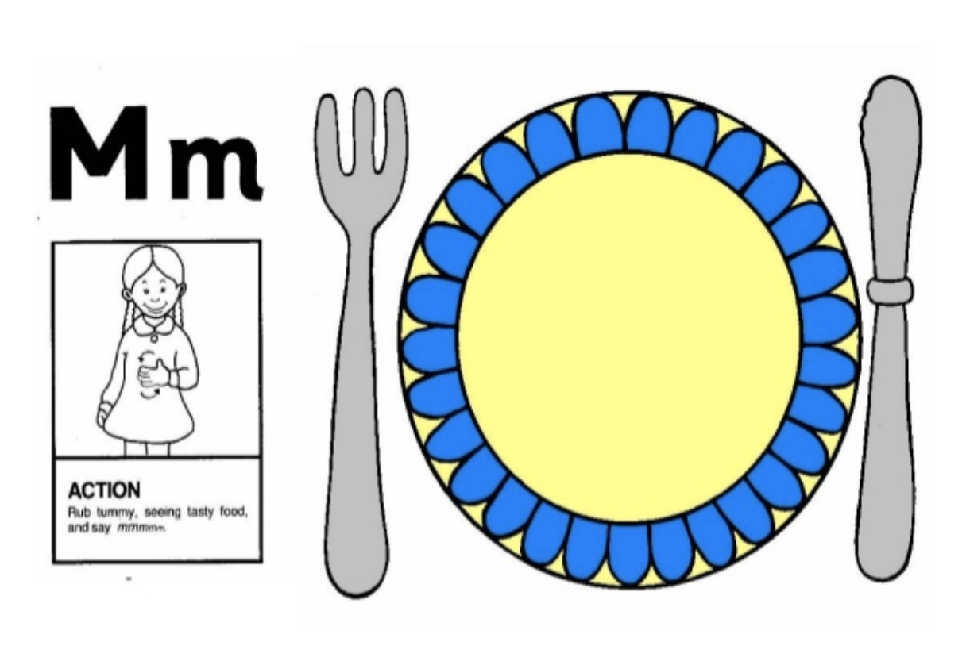
Jolly Phonic Songs in order (Click for here link)

Slide 15
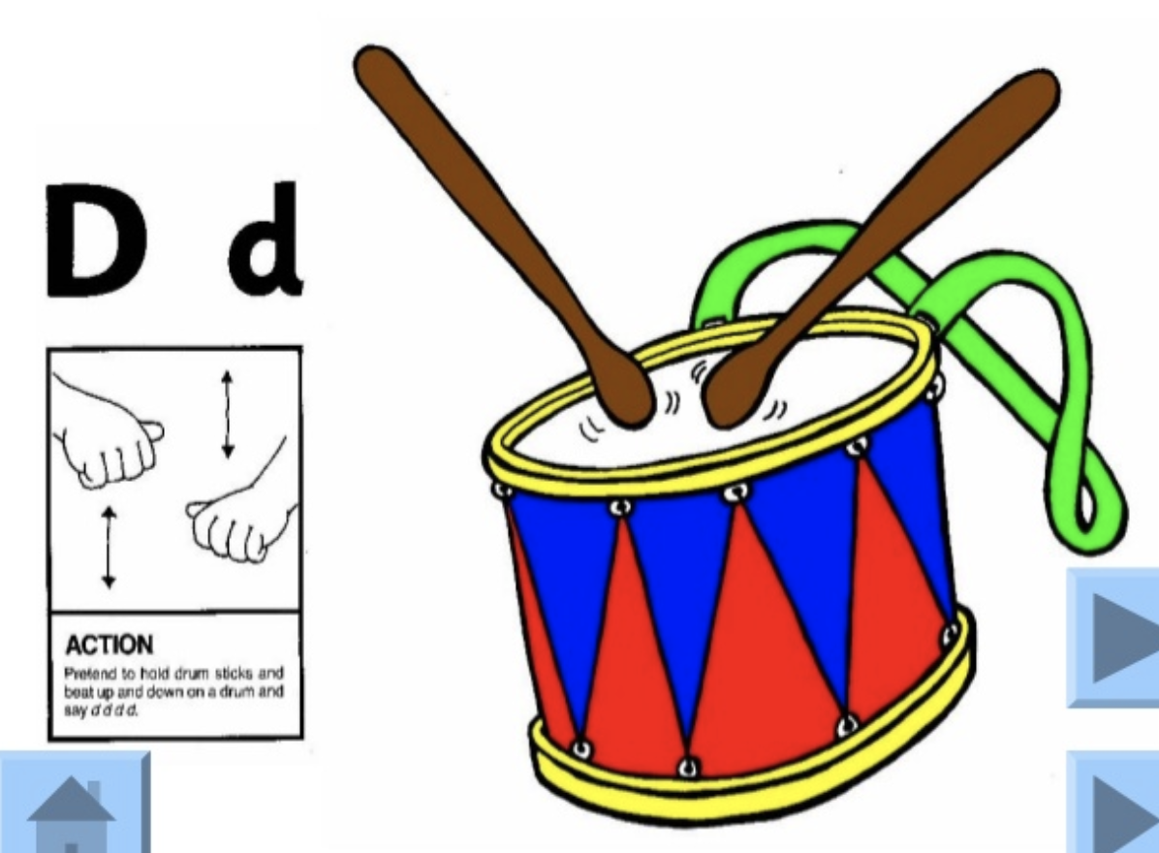
Jolly Phonic Songs in order (Click for here link)

Slide 16
Group Three: g, o, u, l, f, b

Slide 17
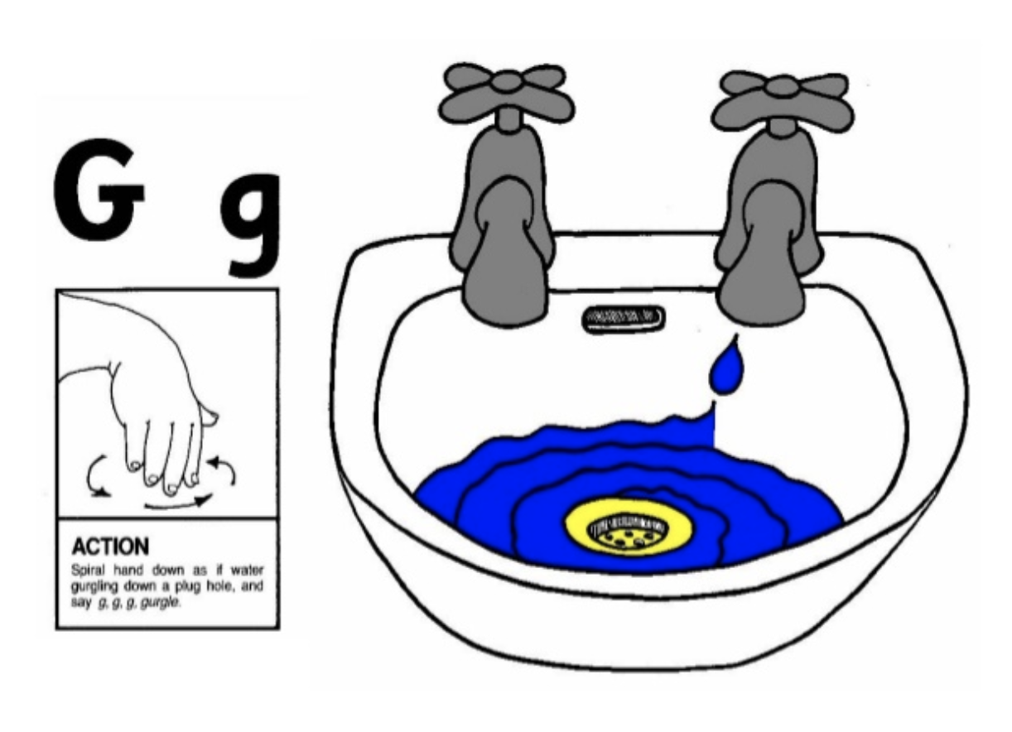
Jolly Phonic Songs in order (Click for here link)

Slide 18
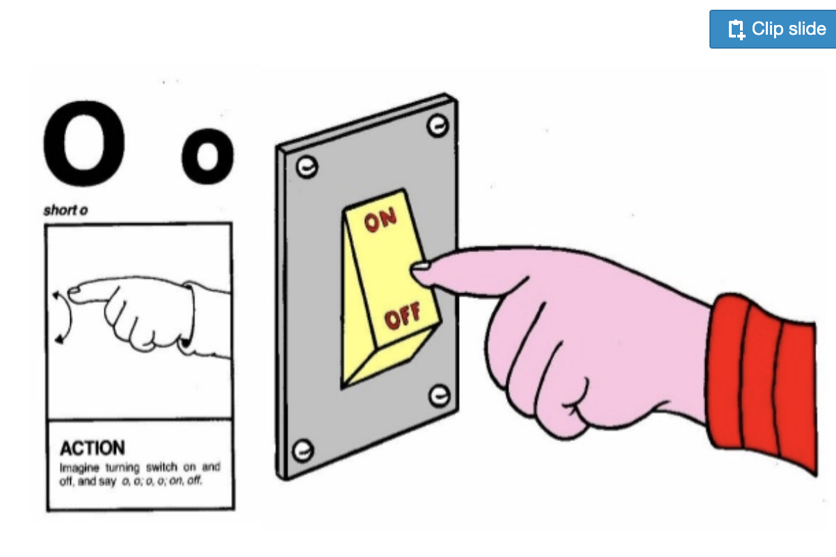
Jolly Phonic Songs in order (Click for here link)

Slide 19
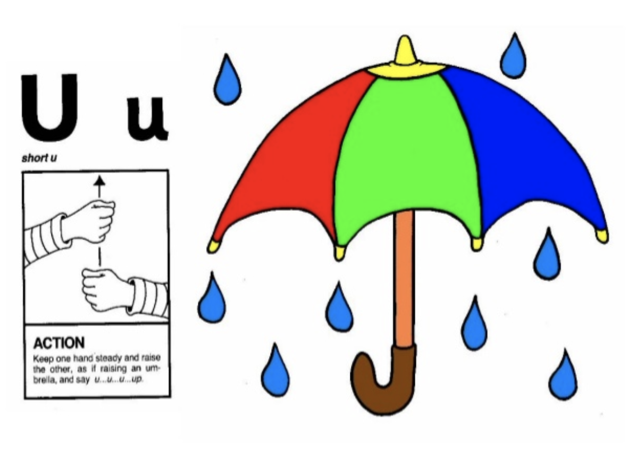
Jolly Phonic Songs in order (Click for here link)

Slide 20
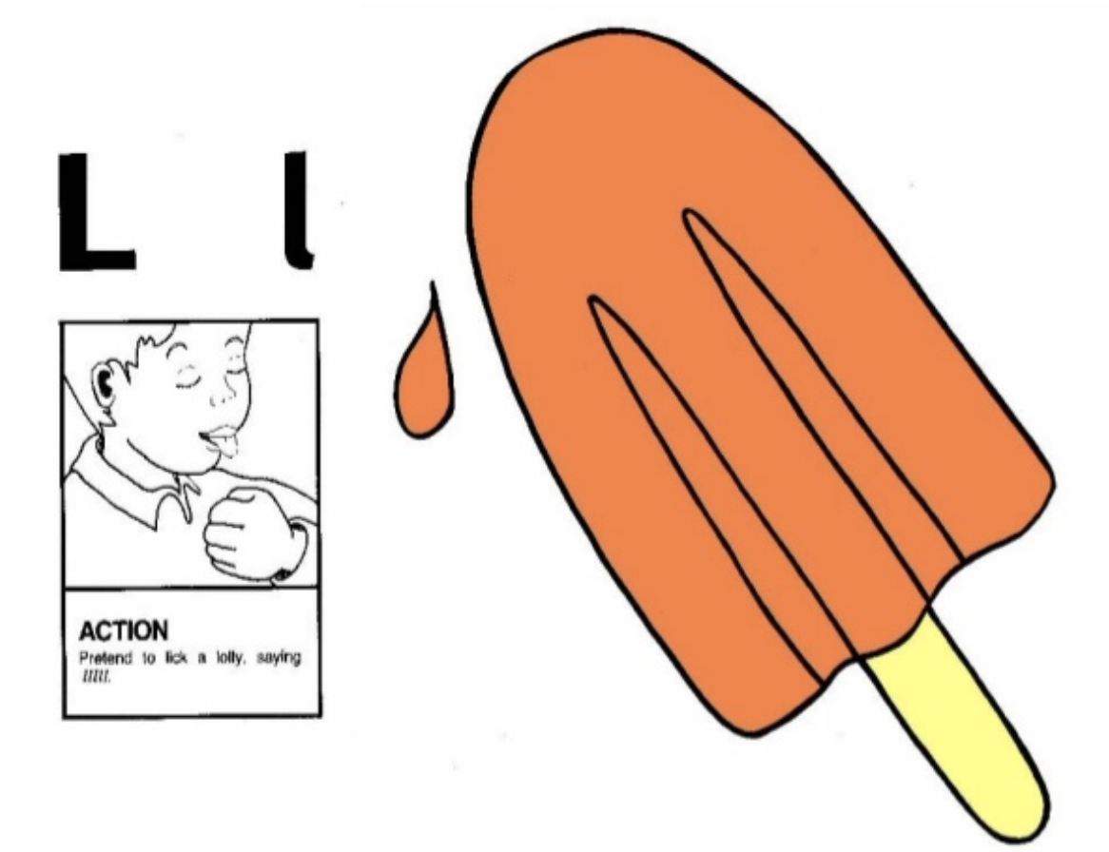
Jolly Phonic Songs in order (Click for here link)

Slide 21
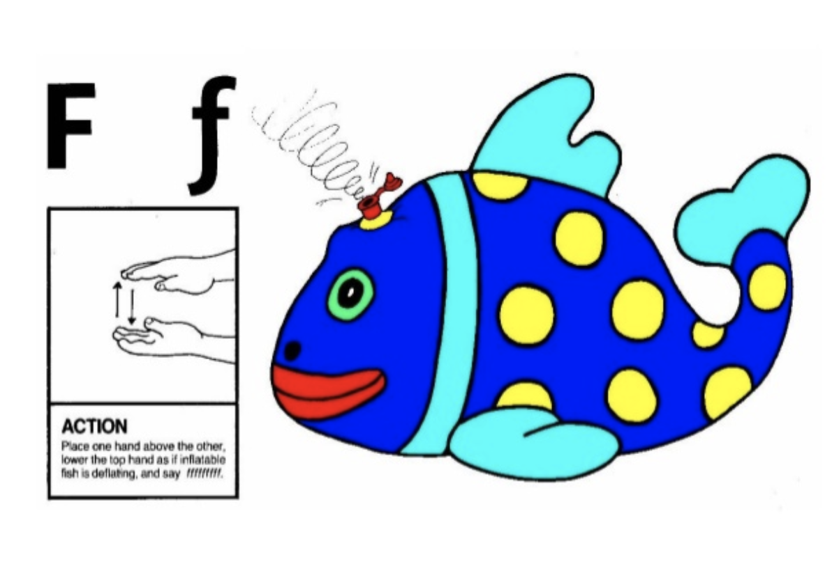
Jolly Phonic Songs in order (Click for here link)

Slide 22
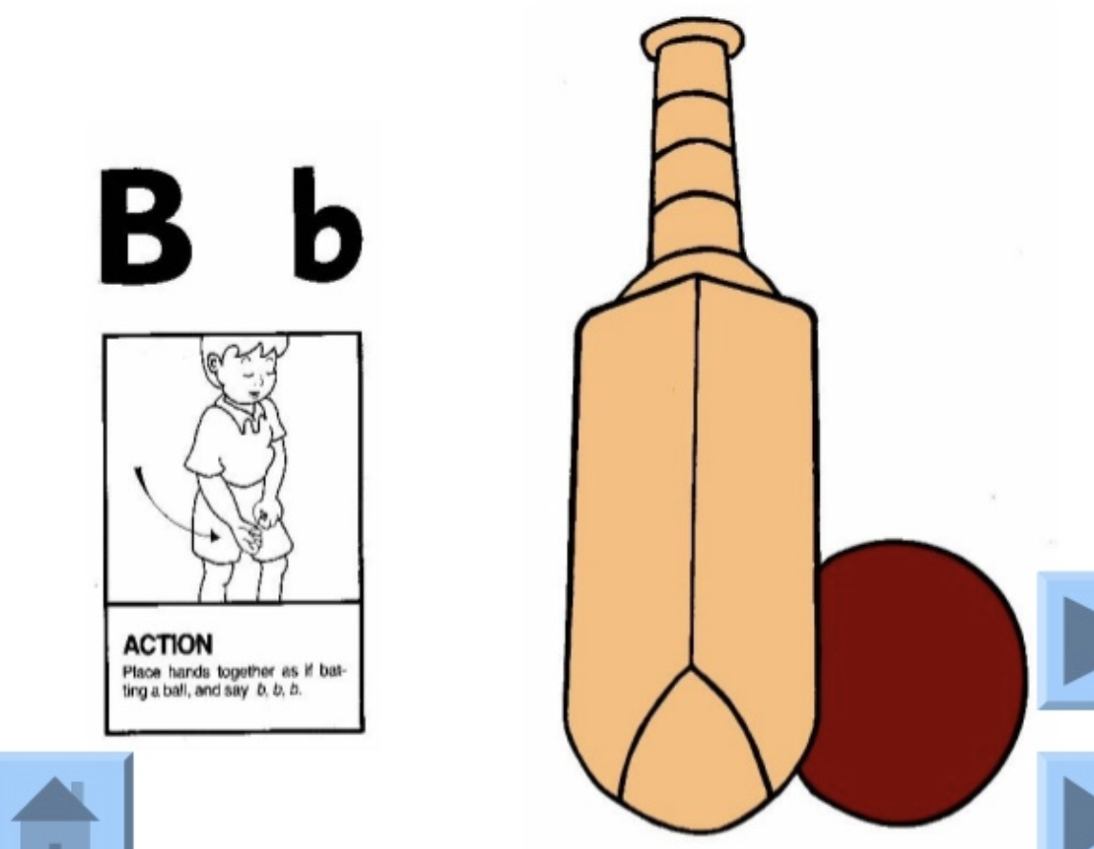
Jolly Phonic Songs in order (Click for here link)

Slide 23
Group Four: ai, j, oa, ie, ee, or

Slide 24
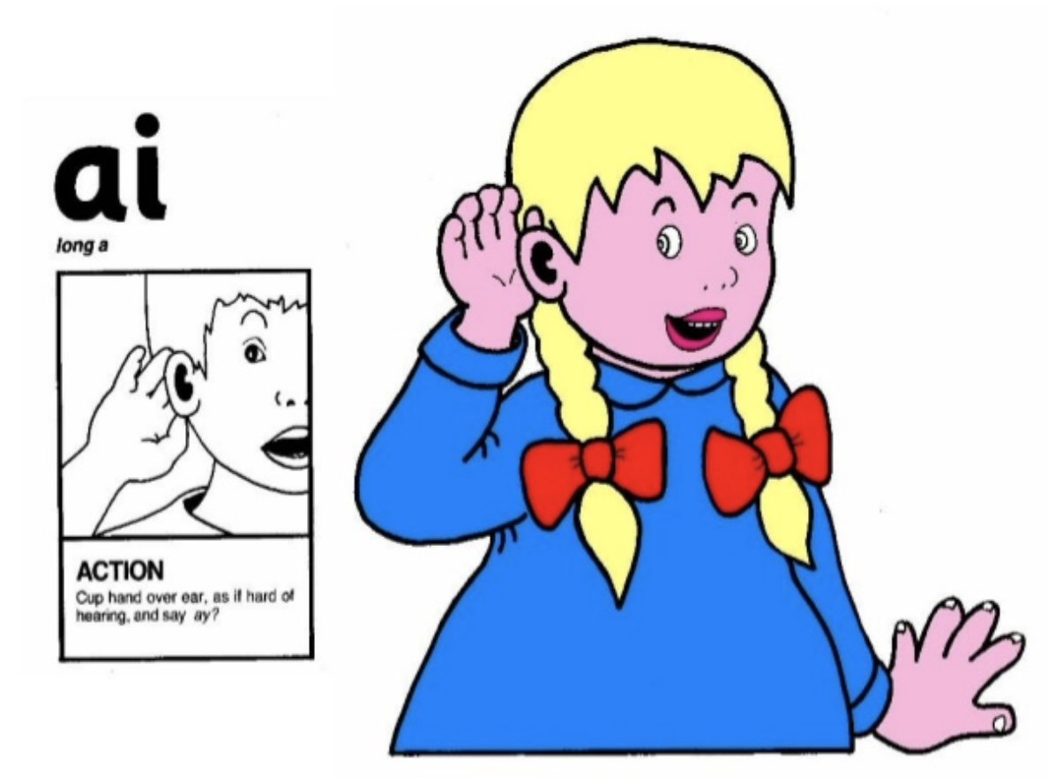
Jolly Phonic Songs in order (Click here for link)

Slide 25
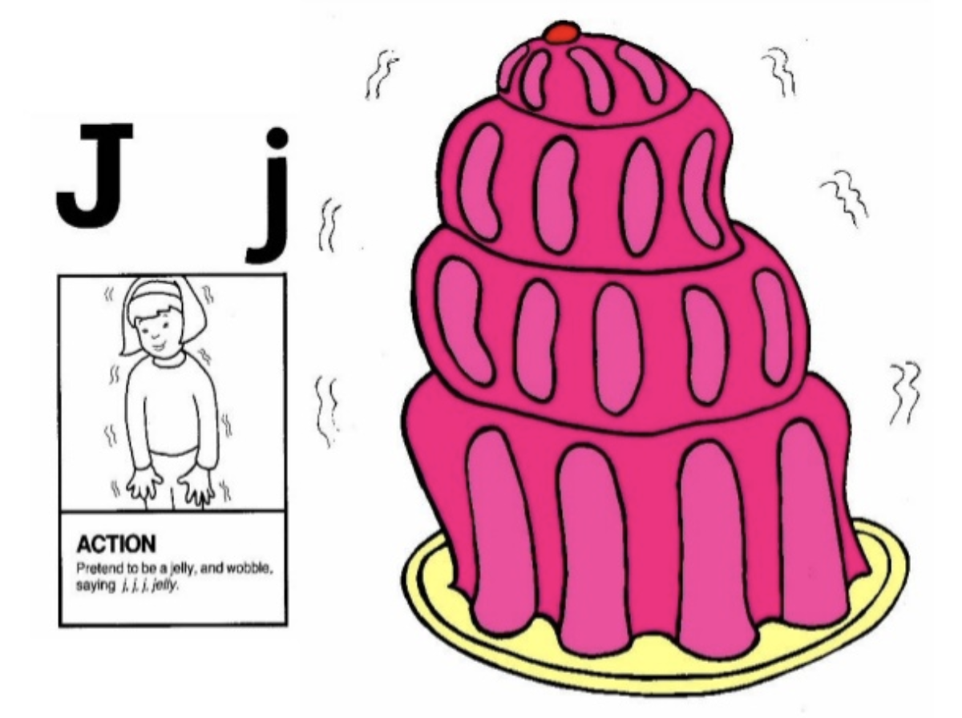
Jolly Phonic Songs in order (Click for here link)

Slide 26
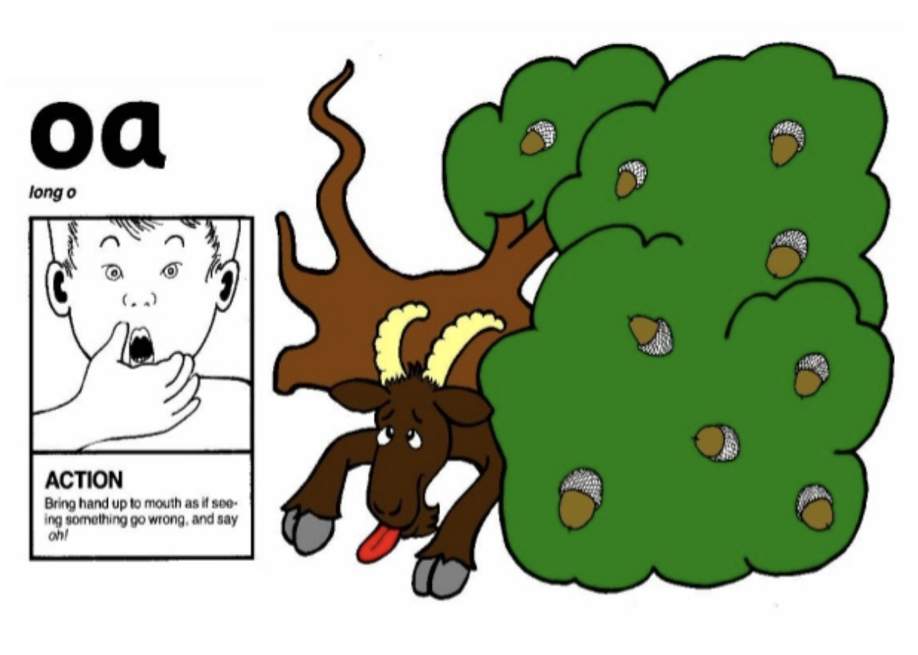
Jolly Phonic Songs in order (Click here for link)

Slide 27
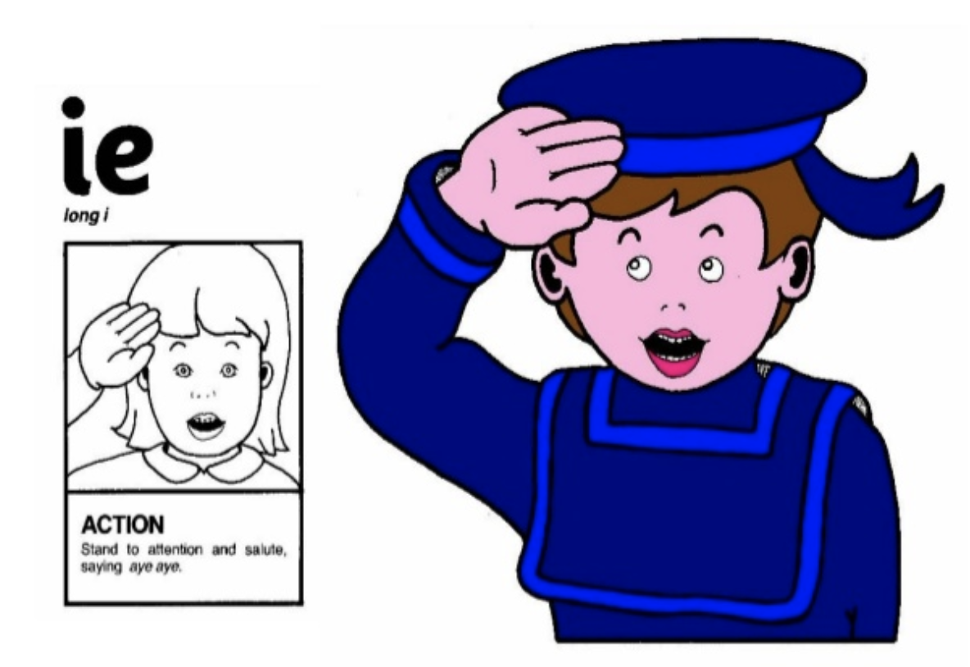
Jolly Phonic Songs in order (Click here for link)

Slide 28
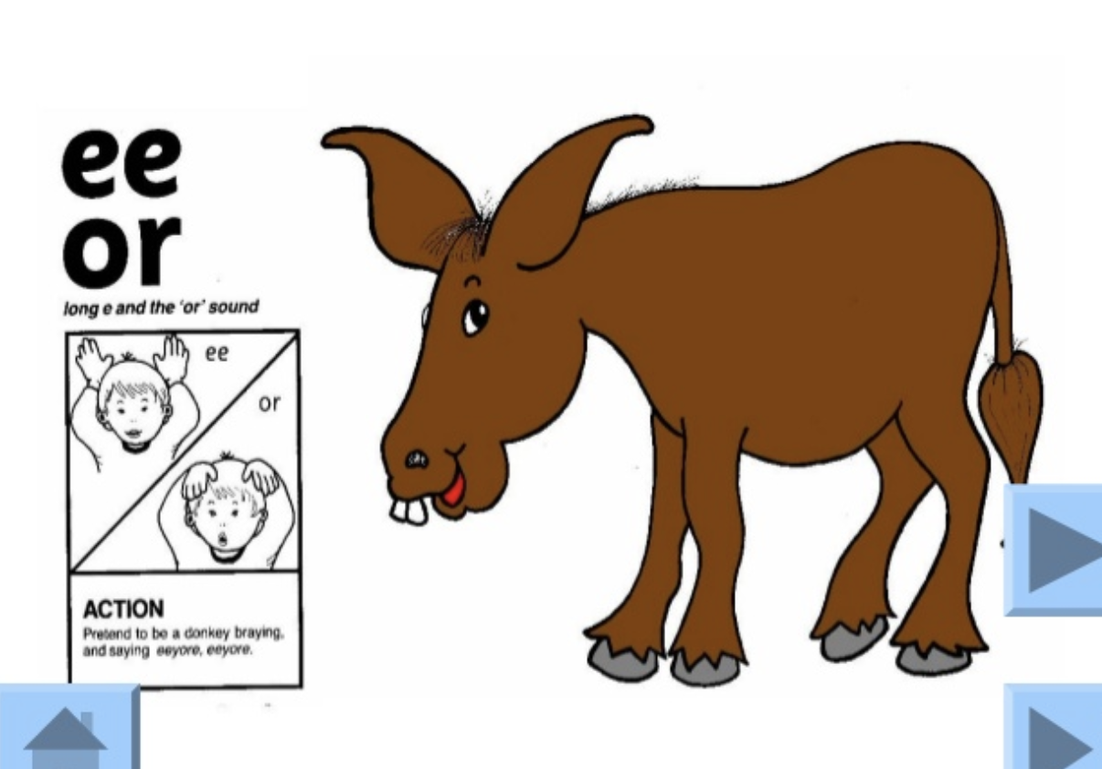
Jolly Phonic Songs in order (Click here for link)

